Slide 1

The Life Cycle of Plastic
Notes:
Sources: https://openknowledge.worldbank.org/handle/10986/35998

Slide 2
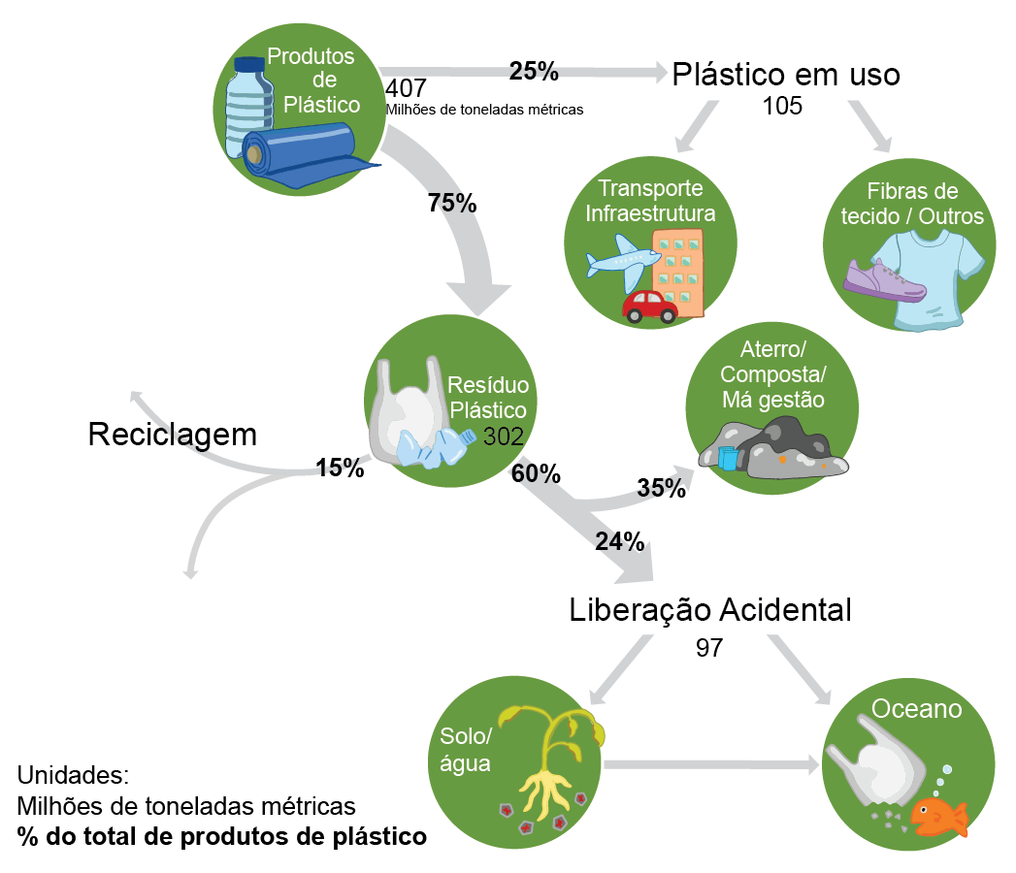
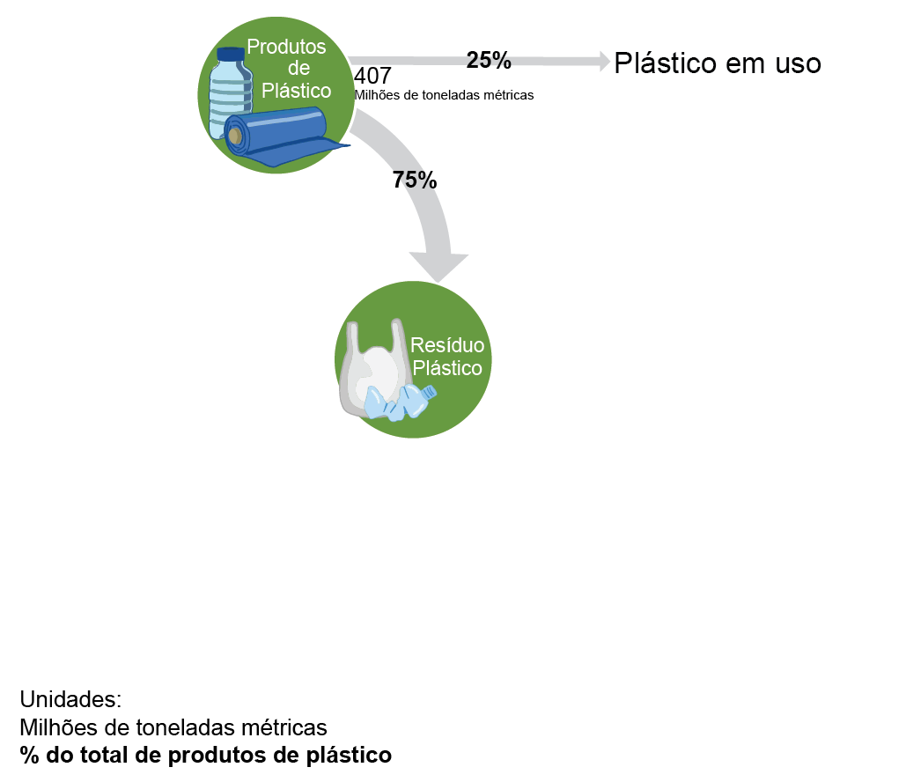
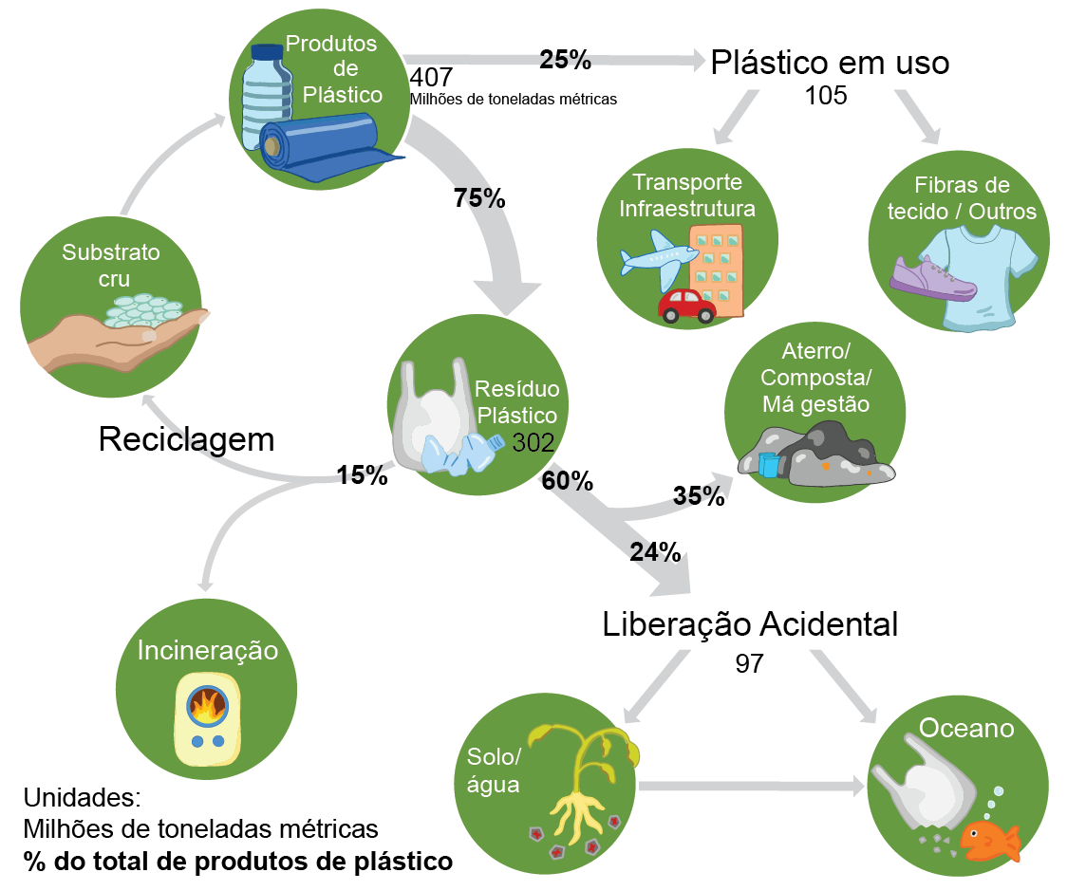
Plastic disposal is a global issue
Figure: Alexis Hocken

Slide 3
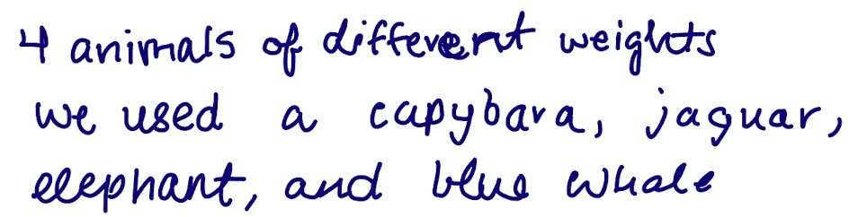
How much is a metric ton?

Slide 4
How much is a metric ton?
140
0.08
0.05
(metric tons)
1

Slide 5

Just how much is a metric ton?
1 metric ton = 1000 kg
Global plastic weighs 160 times more than all living elephants
An elephant weighs up to 5 metric tons
A million metric tons is 200,000 elephants.
There are currently ~500,000 elephants in the world.
https://www.youtube.com/watch?v=n8gfbKVQXz0 (visualization)

Slide 6
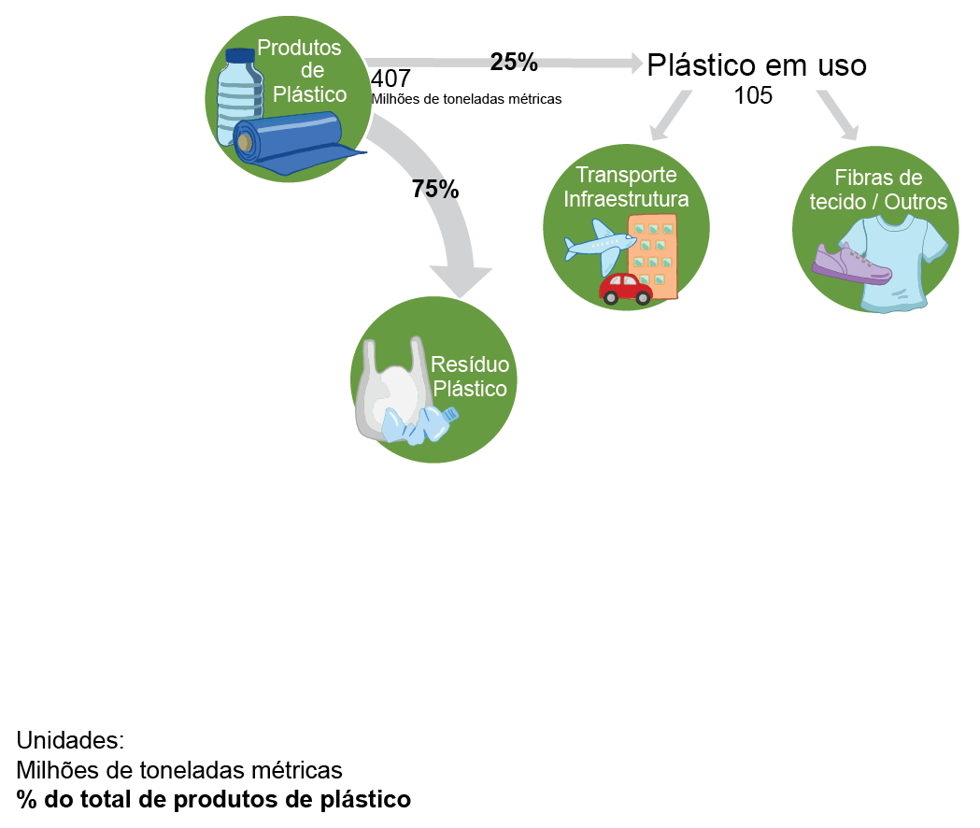
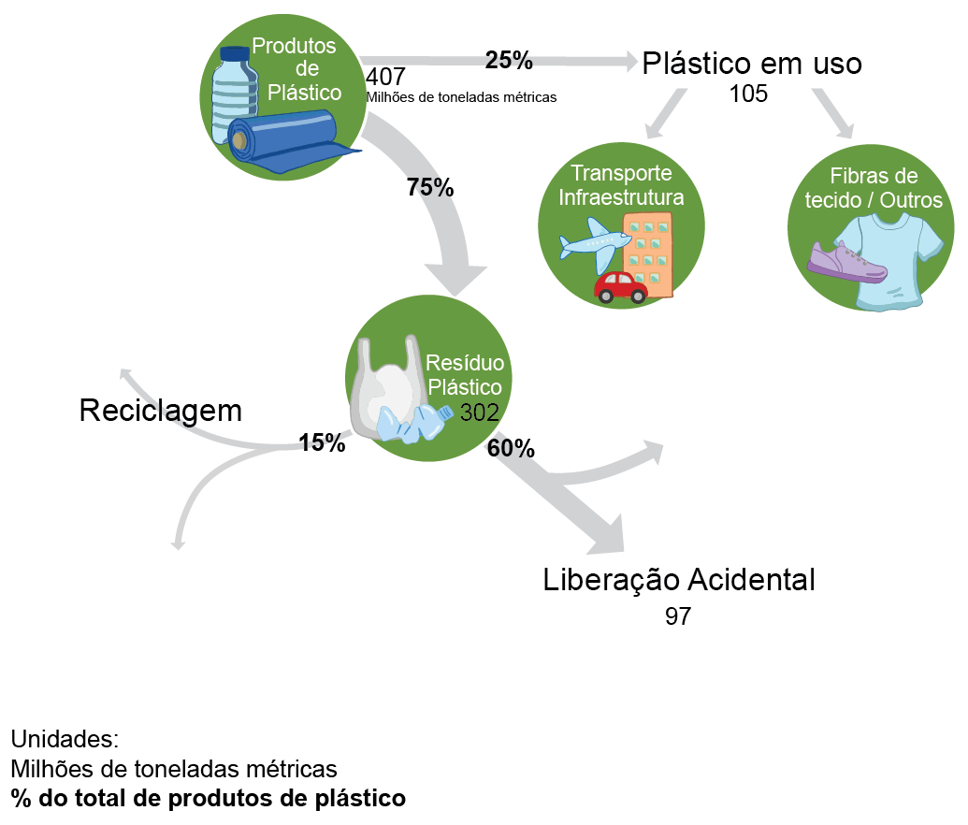
Plastic disposal is a global issue
Figure: Alexis Hocken

Slide 7
Plastic disposal is a global issue
Figure: Alexis Hocken

Slide 8
Plastic disposal is a global issue
Figure: Alexis Hocken

Slide 9
Plastic disposal is a global issue
Figure: Alexis Hocken

Slide 10
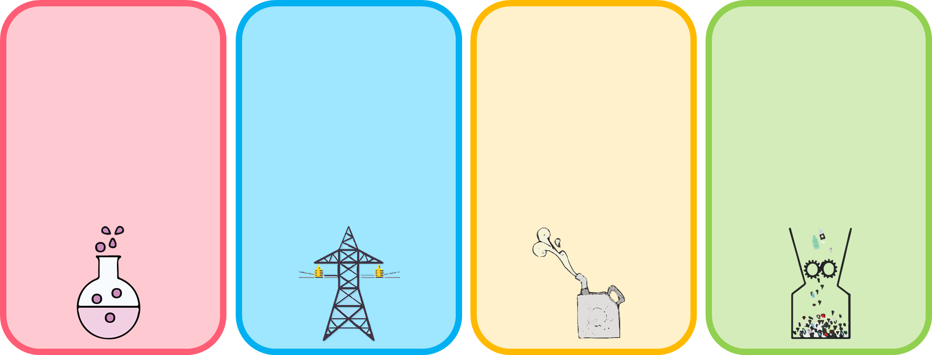
Waste management strategies
Chemical Recycling
Waste-to-energy
Fuel Recovery
Mechanical Recycling
Cleave bonds to recover monomer
Energy intensive
Not scalable
Combust plastics to recover energy (heat or electricity)
Good for pure plastic streams
Break down into shorter carbon chains (4 to 30 carbons long)
Often requires fancy catalysts
Grinding or melting plastics into new products
Leads to polymer degradation

Slide 11
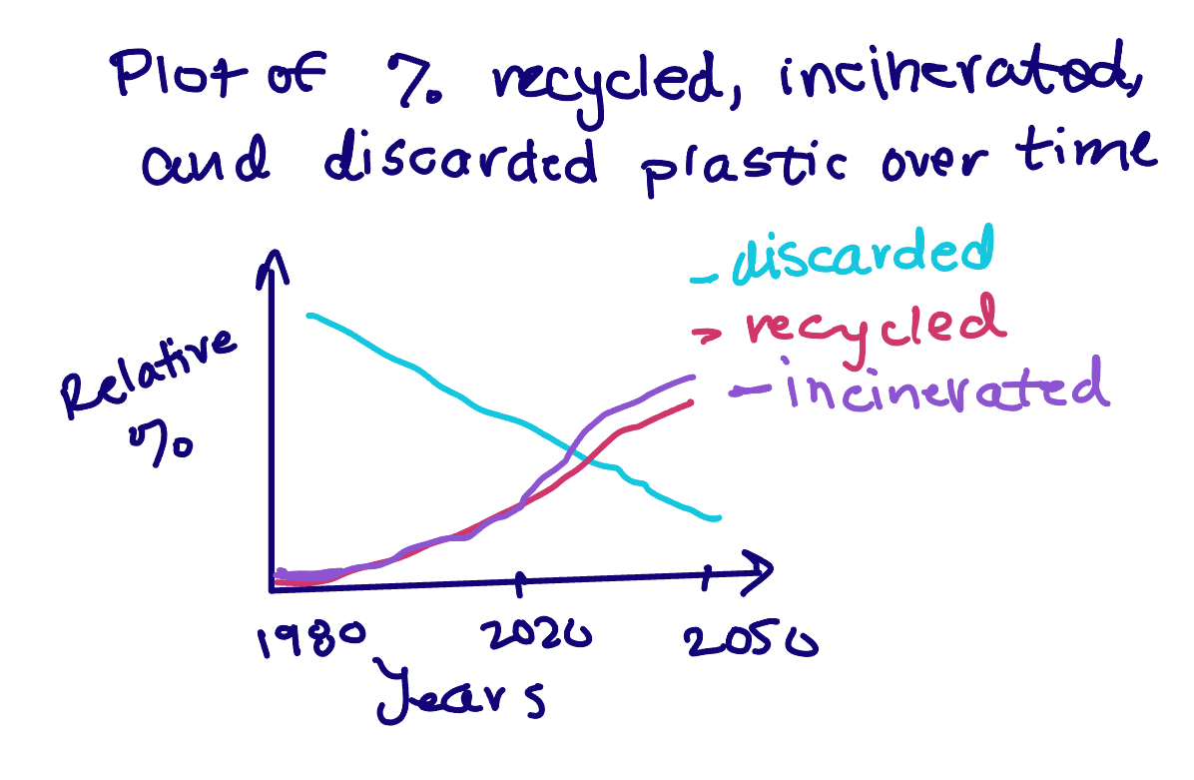
Recycling and incineration are gaining in widespread use
Geryer, R. Plastic Waste and Recycling, 2020.

